Slide 1
2018 P3C Conference Cost of Capital

Slide 2
Cost of Capital

Slide 3
Scenario
Government has elected to do a project DB+ delivery because of complexity and schedule and is seeking advice on whether to include finance and revenue risk as part of the scope

Slide 4
Definitions
General Obligation Bond vs. Revenue Bond
Essential Service Financing vs. Special Facility Financing
Discount Rate
Weighted Average Cost of Capital (“WACC”)
Debt Service Coverage Ratio and Other Reserves
Negative Carry
Underwriter Discounts and Other Financing Costs

Slide 5
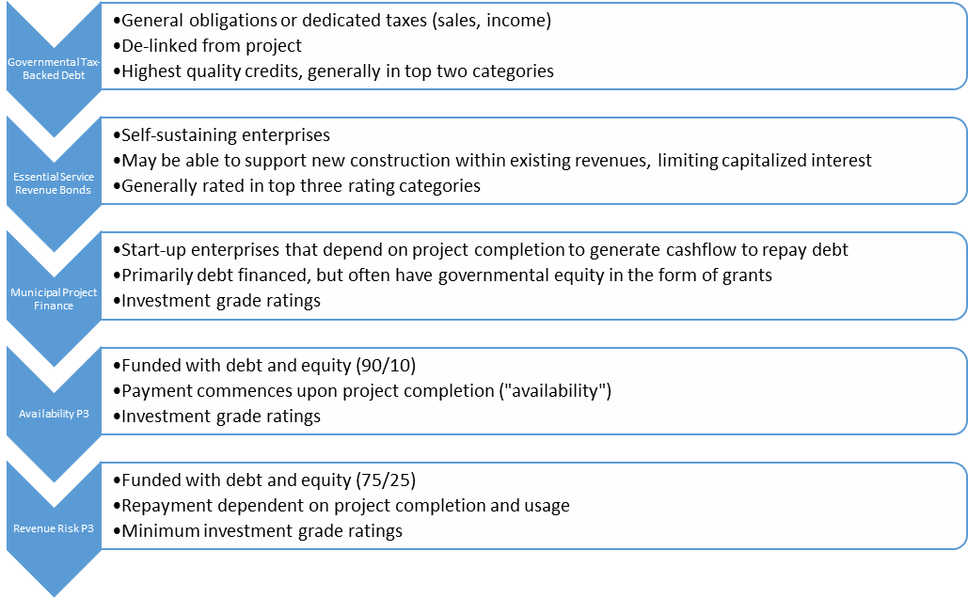
Financing Spectrum for Public Projects

Slide 6
Debt Rating
What is the role of debt rating in a financing?
What is the difference between a debt rating for a special project financing and a capital plan financing of a number of projects?

Slide 7
Project Delivery Methods – Average WACC

Slide 8
Cost of Capital
In a P3, the private capital providers (lenders and equity) “charge” a premium to assume risk through the addition of equity into the capital structure and a higher interest rate versus “risk free” public debt.

Slide 9
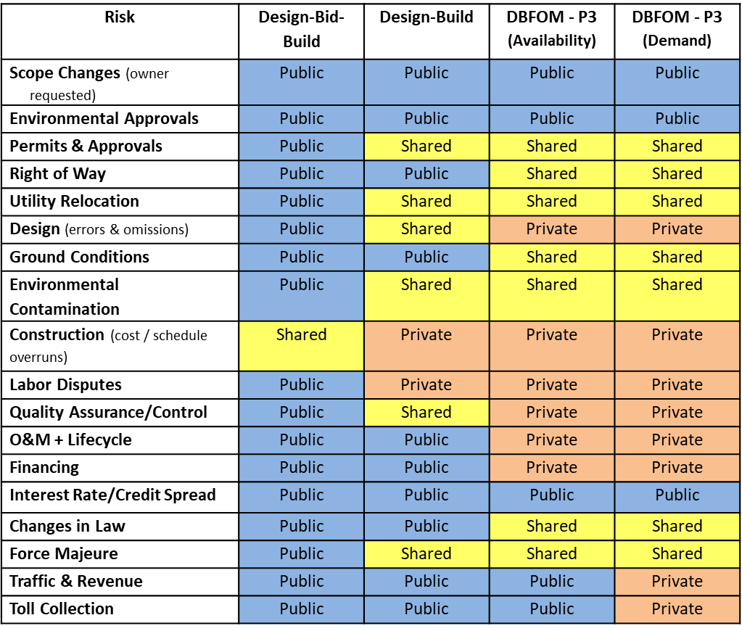
Risk Transfer by Project Delivery
“Risk transfer is akin to buying insurance and has a cost”

Slide 10
Risk Adjusted WACC
The cost of financing an infrastructure project privately is roughly equal to the cost of financing it publically after factoring in the costs associated with the risk of losses (overruns, delays etc.) from the project, which taxpayers ultimately bear.

Slide 11
Tax Implications
Government’s debt is tax-exempt and, therefore, is inherently lower than taxable debt

Slide 12
Example: Long Beach Civic Center
City could not take risk that financial markets could change over time and increase City’s availability payments (lease rate) for the new Civic Center above current levels: Only way to avoid this risk with tax-exempt financing would be to fund 100% of costs at start of 3-year project construction
Upfront full financing would incur significant interest costs during 3-year construction: Construction draws grew over time to peak mid-construction so funds not all required upfront
Tax-exempt financing adds risks to City: Worst case scenarios could mean City is at risk for project completion
Taxable financing could be structured to be drawn only as needed: Amount of taxable debt only as needed so interest costs are only on debt used, matches construction draws

Slide 13
Example: Long Beach Civic Center
Long Beach Civic Center Taxable Financing Cheaper than Tax-Exempt
Following example based on $200m project cost (before interest during construction costs)
Tax-exempt debt (4.5%)
Interest during 3-year construction = $35m
Total financing = $235m
Annual payments = $12.5m
Taxable debt (5.25%)
Interest during 3-year construction = $10m
Total financing = $210m
Annual payments = $12.4m
Construction draws ($/month)
Extra tax-exempt interest

Slide 14
Balance Sheet Risk
Even with tax parity, Government can borrow money cheaper than the private sector (project finance) because its debt is unconditionally guaranteed and, therefore, the cost* to the taxpayer will necessarily be lower if the project is financed by government
* This cost ignores government-assumed project risks

Slide 15
Value Created Through Innovation
Owner’s design specifications
Owner’s award criteria
Whole life cycle savings
Private sector revenue incentives
ATC regime

Slide 16
Example: Sam Rayburn Tollway (SH121)
Municipality will not have to compromise its debt rating if project underperforms
Concept
In 2007, Cintra offered $2.8 billion to build and operate the SH 121 under a 50-year DBFOM contract
After award to Cintra, the regional tollway authority (NTTA) offered TxDOT $3.2 billion
Event
To make $3.2 billion payment, NTTA tripled its outstanding liabilities by raising debt against its entire Dallas/Fort Worth system of toll roads; within the year, rating agencies downgraded NTTA one notch
In response to the financial crisis, NTTA raised the system’s tolls by 32% to meet debt service
Problem

Slide 17
Example: Indiana Toll Road
Concept
Public is not affected if project underperforms
Financial crisis impacts toll revenues and tightens financial markets; after eight years, concessionaire files for bankruptcy in 2014 and lenders sell the asset to a new concessionaire
Event
The State of Indiana does not have to bailout the asset and receives:
An upfront payment of $3.8 billion in 2006 and more than $700 million of rehabilitation works
Shielded from the impact of the financial crisis on toll revenues
Uninterrupted high-quality O&M for 75 years (even if asset changed hands)
Effective transfer of risk
Benefit

Slide 18
Discount Rate
There should be a distinction in the discount rate to be applied in the financial modeling of public finance and private finance.

Slide 19
Diversification Effect
Government has a significant portfolio of projects and, therefore, project risk is discharged through the diversification effect.

Slide 20
Transaction Costs
Transaction costs for a public financing are not materially different than private financing.

Slide 21
Notes:
Poll Title: Cost of Capital: What is your P3 Question? https://www.polleverywhere.com/free_text_polls/EkJEazdPN2REe18

