Slide 1
Deferred Maintenance
Is it the next pension crisis?
P3C
February 27, 2018

Slide 2

Why is this Important?
Orion Fulton, Arup

Slide 3
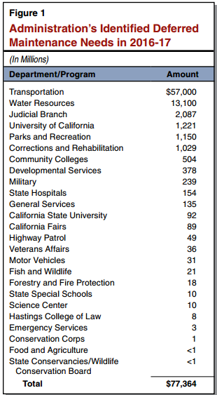
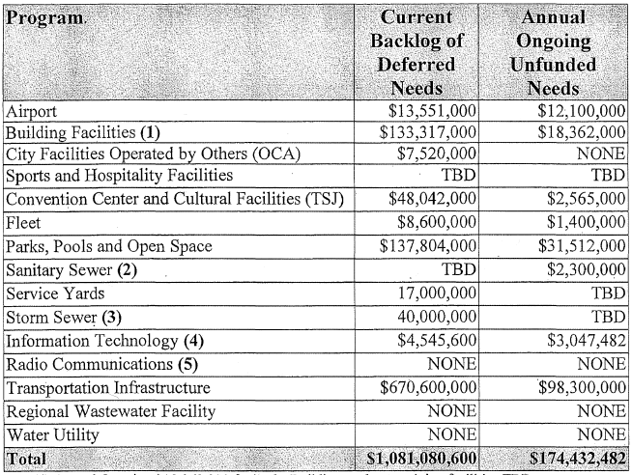
What is the scale?
City of San Jose, 2016
California LAO, 2016
Notes:
San Jose and its taxpayers still are on the hook for an estimated $3.8 billion in unfunded liability in the city’s pension funds and other retirement benefits.
http://www.mercurynews.com/2017/02/20/will-san-joses-pension-costs-consume-revenue-from-new-taxes/
The state’s cost for retiree health and dental benefits has grown to $74.10 billion, according to a report published today by State Controller Betty T. Yee. The so-called “unfunded liability” is a closely watched figure that represents the present-day cost to provide retiree health and dental benefits earned as of June 30, 2015 – one of the state’s largest long-term debts.
http://www.sco.ca.gov/eo_pressrel_16936.html

Slide 4
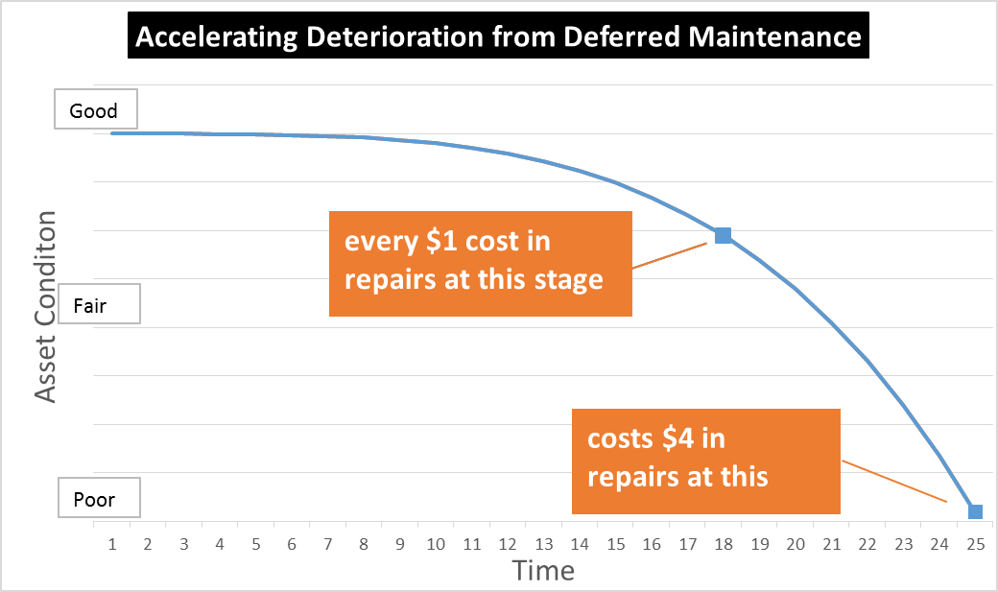
Deferred Maintenance Over Time
Deferred Maintenance occurs because of limited funding
When defects begin to occur they worsen quickly
The cost of repairs compound as facility conditions deteriorates
Repairs are often made but too little too late
© Johnson Controls Inc
Notes:
This is a graph showing how deferring maintenance quickly converts from an operations budget item to a capital project.
Based on how infrastructure is typically funded, a capital project can be funded but maintenance often cannot, leading to a perverse process of decay and replacement rather than good fiscal management of preventing the decay.

Slide 5
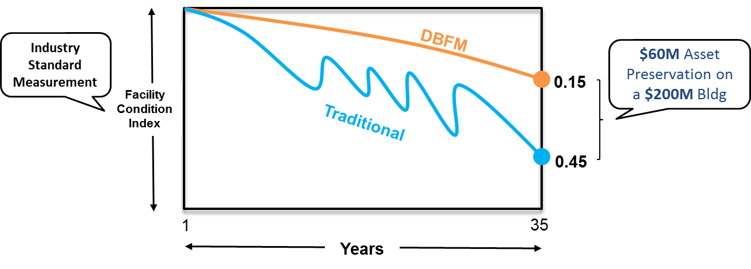
Value of Asset Management and Preservation
© Johnson Controls Inc
  Facility Condition Index (FCI) of 0.15 which equates to 85% of new condition

Slide 6
The Importance of the Fiscal Cycle
Deferred maintenance as public debt?
  Skipping maintenance in bad years = “borrowing”
Catching up during good years = “repayment”
If cost of catch-up > skipped amount = “interest”
In effect, a public-sector “credit card”

Slide 7
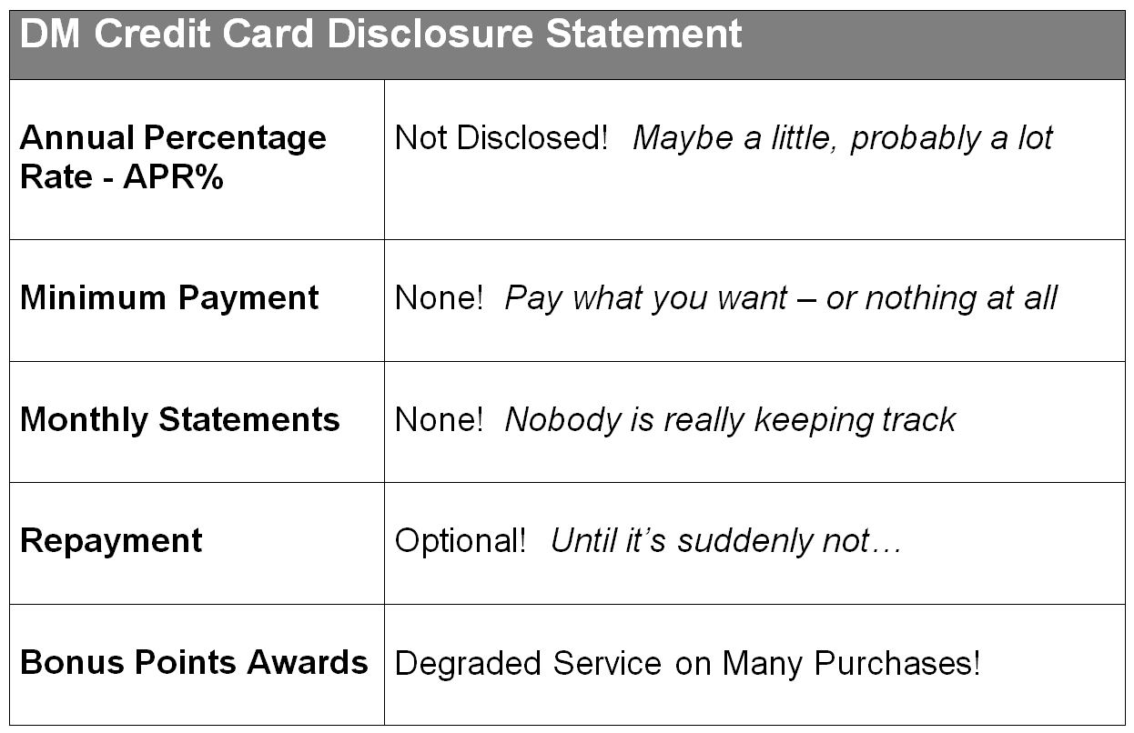
The “DM Credit Card”

Slide 8
Other Important Factors
Generally not subject to a funding formula or mandate to address DM = discretionary
Other obligations (for example Medicaid and pension contributions, or utilities trying to keep rates low) and slow economic growth mean less fiscal capacity for “discretionary” infrastructure investment
GASB 34 Modified approach does not adequately address potential liabilities of DM
Most infrastructure is public and our economy relies on it
Notes:
California measures its state highway infrastructure backlog of deferred maintenance at $78 billion
$2.3 billion per year in fuel tax for funding deferred maintenance
Annual need is roughly $8 billion per year
There is no law that requires the state the fund the shortfall, so the deficits accumulates.
We refer to this as “repressed fiscal deficits”

Slide 9
Recommended Solutions:
Bipartisan Policy Center Executive Council on Infrastructure:
Conduct comprehensive asset inventory
Publish and maintain a project pipeline
Provide the private sector with the full spectrum of potential investment opportunities
Manage assets strategically
ASCE 2017 Report Card:
Use life cycle cost analysis and develop a plan for funding until the end of service life.
Develop tools to ensure that projects most in need of investment and maintenance are prioritized, to leverage limited funding wisely.

Slide 10
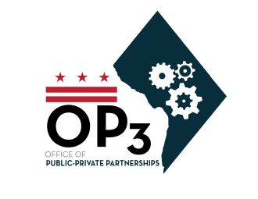

DC OP3
Judah Gluckman, Deputy Director and Counsel

Slide 11
Critical Questions for Quality Infrastructure
What assets do I have that I need to maintain?
  Comprehensive asset inventory (or registry)
What is the quality of the assets I have?
  Facility/asset condition assessments
How will I prioritize my capital needs?
  Develop system to evaluate, rank and prioritize asset maintenance
How much funding do I have to address capital needs and asset maintenance?
  Debt outstanding, debt limits, paygo, federal and other sources of funding

Slide 12
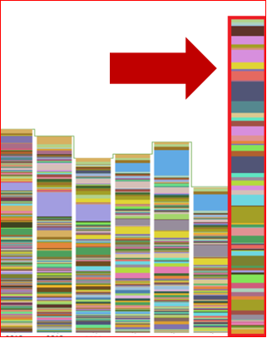
How Do Prioritized Assets Fit My Funding?
District’s Actual 2018-2023 CIP ($6.7 billion)
$4.2 billion unfunded needs
FY 2018
FY 2019
FY 2020
FY 2021
FY 2022
FY 2023
Unfunded

Slide 13
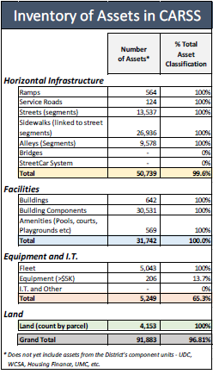
Over 90,000 assets tracked in CARSS – representing 96% of the District’s capital inventory

Slide 14
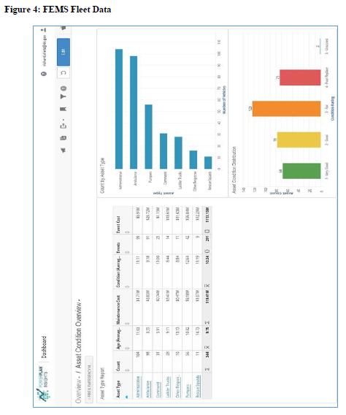
Methodology is
key

Slide 15
The District’s Solution (The 5th Step)
to $4.2 Billion in Unfunded Projects
New District law gradually increases paygo (cash funding) levels to equal annual depreciation.
Issuing debt up to the statutory limit, refunding existing debt and utilizing higher paygo levels will allow all deferred maintenance to be addressed by 2028.

Slide 16
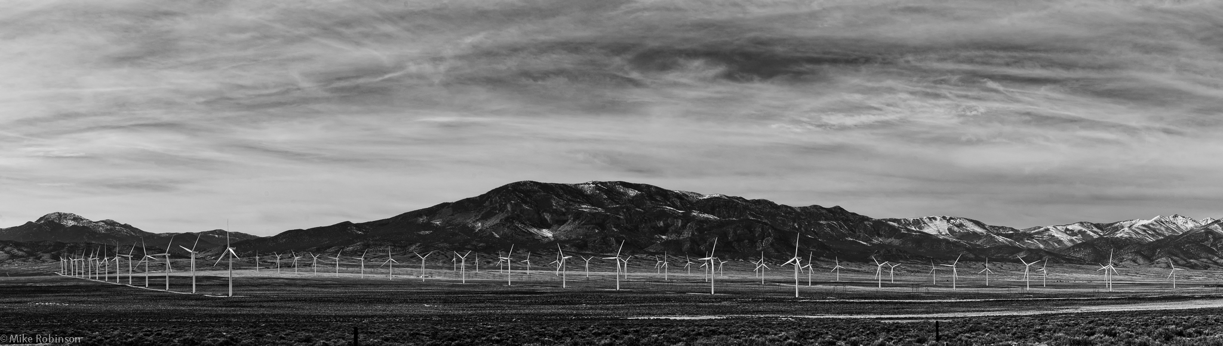
Credit Questions
Anne Selting, S&P Global
Copyright © 2016 by S&P Global.
All rights reserved.

Slide 17
Why DM is Different than the Pension Crisis
  Fundamentally we think there is more flexibility to address DM, relative to pensions
  DM doesn’t have the same legal/constitutional claim on a state/local government resources--more flexibility to manage backlogs relative to pension obligations
  Also, there is better potential to raise new revenues to fund infrastructure investments. Since 2012, at least 30 states have passed some combination of transportation-infrastructure related gas/vehicle registration fee increase.
  Trump infrastructure plan could incent more revenue-based, self sustaining projects (intrastate tolling) that rely on user fees.
  But we do see a massive backlog that could weigh on economic growth prospects.
Notes:
We have even cited the backlog as an offsetting credit factor in our California rating report (I would also note there is an effort afoot to put a measure on the ballot to reverse those increases. It hasn’t qualified yet, but if it did, it’s unclear how the state would respond):

Slide 18
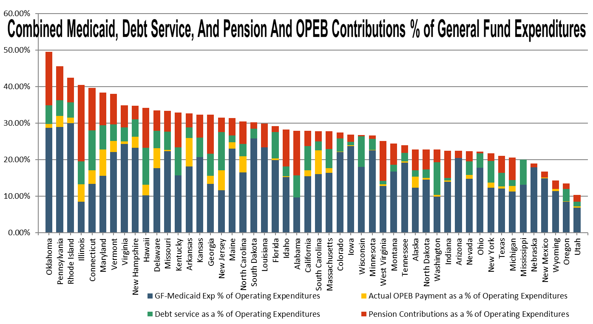
DM Competes with Other Fixed Obligations

Slide 19
And Some States/Govts Have Less Financial Flexibility
2013
2014
2015
2016
2017*
Upgrade
Downgrade
Source: S&P Global Ratings History of U.S. State Ratings 10/13/17. *As of 10/13/17. Includes multiple rating changes for same state within a year
Notes:
19

Slide 20
If DM is Key Risk Its In Ratings, But Exposure is Not Necessarily a Ratings Risk
Relative Ranking (Outside of Rating Analysis)
DM is a Factor in the Rating
(Inside the Ratings Analysis)
Vs.
County X:
A- credit rating
High Deferred Maintenance
County Z
Credit Consideration
Key credit factor
Ratings driver
County Y:
A- credit rating
Low Deferred Maintenance
Value for investor but unclear rating relationship (high DM ≠ high rating pressure. Not predicative, informational
High DM enters the ratings analysis
Some cross over from relative ranking possible

Slide 21
High DM Credit Impacts Are Situational, and Index Viewed in Context
No Impact on Ratings
  Ability to implement a significant capital investment/deferred maintenance program over a number of years
  Good financial headroom to avoid liquidity crisis, financial metric deterioration, covenant trips
  Customer base robust enough to absorb rate/user increases (deep user base with strong income indicators)
  Likely larger systems will see fewer deferral impacts
Ratings Downgrade
  Rapid infrastructure failure precipitates investment over short period
  Limited headroom, metrics don’t support current rating
  Shallow customer base (or rate/user increases occur but leads to downward spiral as it accelerates customer loss or substitution)
Default/Restructuring
  Most likely small systems that experience catastrophic infrastructure failure that leads to precipitous decline in credit quality
  Individual/management accountability possible
  More liquidity for all systems with vulnerable infrastructure
  Given parameters of Chapter 9 is this even really a risk?

Slide 22
Example of How DM Enters Our Rating as a Credit Consideration
Rating Report for California’s Feb. 22 $1.5 billion general obligation offering and $600 million GO refunding bonds, rated AA-/Stable outlook:
Somewhat offsetting these strengths, in our view, are the state's:
Persistently high cost of housing relative to that in other states, which contributes to a relatively weaker business climate in California, posing a threat to longer-term economic growth prospects;
Difficult-to-forecast revenues because of volatile revenue base correlated with financial market performance as well as a reliance on a highly progressive personal income tax (PIT) structure;
Minimal prefunding of retiree health care benefits (other postemployment benefits, or OPEBs), although the state has reached agreement with its labor bargaining units to phase in over several years normal cost contributions; and
Large backlog of deferred maintenance and infrastructure needs, though with a recently enacted package of revenue enhancements for the state's highway infrastructure, the state has funding sources with which to address it.

Slide 23
Key Credit Questions
Can the public finance industry do a better job of measuring and disclosing standardized DM information?
What data is needed to develop deferred maintenance metrics that measure this risk?
Similar to Environmental-Social-Governance (ESG) issues facing corporate debt issuers, should public entities need to consider if DM is part of this or a related paradigm?
Could be a key area for public finance governance, as so much of U.S. infrastructure is held by government entities
Information may not be lead to or be predictive of ratings transitions but possible in some cases

Slide 24

State of Research
Michael Bennon, Stanford Global Projects Center

Slide 25
Commonly Cited Causes of Deferred Maintenance
Historical building rhythm
Lack of public interest – no immediate implications
Lack of political interest – politicians focus on “ribbon cuttings”
Routine maintenance is a low priority for governments – an ad hoc approach to future maintenance planning
Competition with other spending requirements
Political short-termism

Slide 26
Additional Deferred Maintenance Hypotheses in Literature
Funding Mechanism: Infrastructure assets with a dedicated revenue stream (project finance) will exhibit fewer signs of deferred maintenance than assets in which maintenance is subject to an annual appropriation
Institutional Bifurcation: When one agency/institution is responsible for Capital Expenditures and another is primarily responsible for Operations and Maintenance, maintenance spending is more likely to be deferred

Slide 27
Is maintenance deferred because politicians, citizens don’t prioritize maintenance spending?
Aggregate Infrastructure Spending Breakdown – US Transportation and Water Infrastructure ($Bn 2014)
Infrastructure Spending Share shifts to state, local government
Federal spending remains at early 80’s levels

Slide 28
Federal Spending and Deferred Maintenance
One Level of Government for Capital Spending, Another for Operations and Maintenance

Slide 29

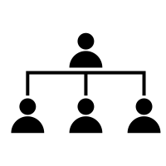

Annual Budget Cycles and Deferred Maintenance
Annual Maintenance Budget Process
+
Cyclical Industry
Scenario 1: Costs are Lower than Expected
  “Use it or Lose it” Scenario this year
  May negatively impact budget assessment next year
Treasury/Legislature
Agency
(e.g. Transport, Water)
Scenario 2: Costs are Higher than Expected
The Underfunded Agency Dilemma
Potential Solutions?
  Layoffs/Furloughs
  Innovate to reduce annual costs
  Defer Maintenance Projects
Public Assets

Slide 30
Proposed Research Agenda
Study of deferred maintenance escalation over time
Comparable studies of similar assets under cyclical maintenance appropriations and concession or other life-cycle maintenance spending
Comparable studies of maintenance spending for public utilities based on stability of annual revenues
Improved accounting and budgeting systems for public asset management
Long Beach Civic Center – Estimate of Rehabilitation Costs
Updated 2013 Estimate
2006 Rehab Estimate
Escalated at 5%

Slide 31
Next Steps
Orion Fulton, Arup

