Slide 1
P3 for Small and Midsize Governments
How Any Government Entity, Regardless of Size, Can Utilize the Cost Saving Benefits of P3s

Slide 2
Nationally recognized not-for-profit
Maximizes public benefit when using P3
Access to Tax-Exempt financing
Issues bonds
Owns the project on behalf of Public Entity until debt is retired
Transfers project at no additional cost to public agency

Slide 3
Redmond City Hall
Redmond, WA
Pop. 62,500
$39.2 Million Project

Slide 4
UAF Woods Center Food Services
University of Alaska Fairbanks, AK
Student Pop. 9,330
$23.6 Million Project

Slide 5
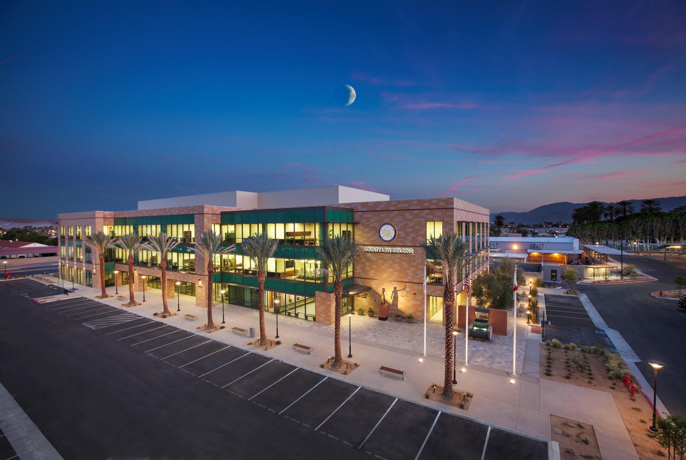
Riverside County Courthouse
Indio, CA
Pop. 88,400
$44.38 Million Project

Slide 6
Other Examples
Patricia Bracelin Steele Building | $62,540,000
Radford Court Apartments | $53,125,000
Pacific Place Parking Garage | $47,000,000
King Street Center | $78,275,000
Lake Tapps Parkway | $17,000,000
4225 Roosevelt | $29,858,000
The Gateway at Alhambra | $43,710,000
Issaquah Highlands | $63,500,000
Redmond City Hall | $39,230,000
Bothell City Hall | $49,625,000
Edna Lucile Goodrich Building | $56,805,000
Nordheim Court | $34,085,000

Slide 7
What’s challenging about smaller governments?
Typically a Lower project cost
Smaller projects cannot afford higher cost of conventional debt and equity
Smaller projects have little room to accommodate the higher costs of long term O&M packages
Smaller Governments are typically less experienced with complex projects

Slide 8
Key Considerations for Public-Private Partnerships in Social Infrastructure
There is no Capital Availability Gap for Social Infrastructure!
The issue, to the extent it exists, is a Revenue Availability or Revenue Allocation issue
P3 for Social Infrastructure builds, leases and then transfers projects to governmental tenants.
To be a successful P3 for Social Infrastructure:
Deliver lower costs, higher quality and greater efficiency.

Slide 9
Two Models
New American Approach
Availability Approach
Ownership | Through an “On-Behalf-Of” not-for-profit | Public ownership with private control
Financing | 100% tax exempt debt | Equity and taxable debt
Development | Private build-to-suit; Integrated Delivery with incentives to perform | Private build-to-suit; Integrated Delivery with incentives to perform
Operations & Maintenance | Privately delivered, cost-based & subject to performance review. Dedicated repair and replacement reserve | Private availability-based Privately delivered and funded through long-term public obligations
Lifecycle Cost | Lowest in the industry | Generally higher to cover availability contracting
Property Tax | Usually exempt | Typically subject to property tax

Slide 10
Four Principles How to Maximize Public Benefits in P3 Delivery for Social Infrastructure
Use Tax-Exempt Debt
Use Private Development
Align Risks and Rewards
Understanding the Origins of Value

Slide 11
Four Principles: The Use of Tax-Exempt Debt
Tax-Exempt Financing | Taxable Financing
100% Tax Exempt Debt | Combination of Taxable Debt and Equity
Required Debt Coverage Ratio is 1.0 | Required Debt Coverage Ratio is 1.1 or higher
A Single Loan | Two Loans – A Construction Loan and then a Permanent Loan
More accepting of Subject to Appropriation and Abatement language | Difficulty with Subject to Appropriation and Abatement language

Slide 12
Four Principles: Use of Private Development
Developers Work Efficiently – Time is Money!
Use Incentives to encourage efficiency
In-House Experience
Rely Less on Consultants

Slide 13
Four Principles: Alignment of Risks and Rewards
Pay partners fairly for what they bring to the project
Do not pay for what they do not bring to the project
Private partners must be allowed to freely apply their knowledge, skill, management and experience
Keep private property management competitive with short term, performance based O&M contracting.

Slide 14
Four Principles: Understand the Origins of Value
As 100% tenant, the public agency lease creates the value allowing the project to move forward.
Rent always = Debt Service + Operations + Maintenance
The contracts allocate risk
Rewards should reflect contributions:
Fees, Benefits, Incentives
Ability to direct operations
Ability to take control of the project

Slide 15
Intelligent Lifecycle Costing
Lowest Cost of Money
+
Greatest Development Efficiency
+
Most Efficient Operations
+
Active Maintenance
Intelligent Lifecycle Cost

Slide 16
The New American Approach in Eight Steps

Slide 17
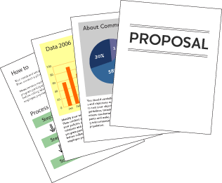
The New American Approach: Step 1: Selecting the Not-for-Profit Partner
What to Look For in a Not-for-Profit
Experience in complex real estate development
Experience in tax-exempt bond finance and compliance
Asset management
Property management
Keep in mind the Not-for-Profit is not a contracted consultant and their fee compensation will come from bond proceeds
Public Agency
RFQ/RFP
Not-for-Profit Partner
Not-for-Profit Partner
Not-for-Profit Partner

Slide 18
The New American Approach: Step 2: Selecting the Private Development Team
Issue an RFQ
Identify team members
Ask for their experience on similar projects
Ask for references
Does not ask for design concepts or costs
Public Agency
Not-for-Profit Partner
RFQ/RFP

Slide 19
The New American Approach: Step 2: Selecting the Private Development Team
Issue an RFP for the Development Team
Who are the Team Members
What are their time commitments & experience on similar projects?
How does the team expect to create public value?
Will they accept the terms of the pre-development agreement and the development agreement?
Ask for them to bid all fees and soft costs based on an assumed per square foot hard cost.
Ask them to confidentially provide financial information and litigation history.
Public Agency
Not-for-Profit Partner
RFQ/RFP

Slide 20
The New American Approach: Step 2: Selecting the Private Development Team
Public Agency
Not-for-Profit Partner
RFQ/RFP
Do Not ask for Architectural Renderings!

Slide 21
The New American Approach: Step 2: Selecting the Private Development Team
Digging Further
Interview the Teams
Also conduct separate interviews for each team member
Visit their projects
Examine their financials and litigation record in the team’s offices
Interview other Public Agencies
Public Agency
Not-for-Profit Partner
RFQ/RFP

Slide 22
The New American Approach: Step 2: Selecting the Private Development Team
Public Agency
Not-for-Profit Partner
Development Team
RFQ/RFP
Developer
Development Team
General Contractor
Architect
Developer
Development Team
General Contractor
Architect
Developer
General Contractor
Architect

Slide 23
The New American Approach: Step 2: Selecting the Private Development Team
Public Agency
Not-for-Profit Partner
Development Team
Developer
General Contractor
Architect

Slide 24
The New American Approach: Step 2: Selecting the Private Development Team
Public Agency
Not-for-Profit Partner
Development Team
Developer
General Contractor
Architect

Slide 25
OR

Slide 26
The New American Approach: Step 1: Issuing the RFP
Public Agency
RFQ/RFP

Slide 27
The New American Approach: Step 2: Selecting the Private Development Team and Not-for-Profit Partner
Public Agency
Development Team
RFQ/RFP
Developer
Development Team
General Contractor
Architect
Developer
Development Team
General Contractor
Architect
Developer
Not-for-Profit Partner
General Contractor
Architect

Slide 28
The New American Approach: Step 2: Selecting the Private Development Team and Not-for-Profit Partner
Public Agency
Development Team
Developer
General Contractor
Architect
Not-for-Profit Partner

Slide 29
The New American Approach: Step 2: Selecting the Private Development Team and Not-for-Profit Partner
Public Agency
Development Team
Developer
General Contractor
Architect
Not-for-Profit Partner

Slide 30
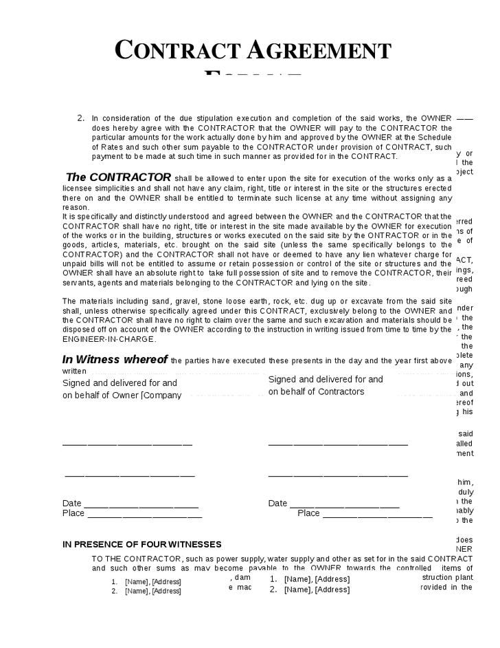
The New American Approach: Step 3: Design and Predevelopment
Pre-Development Agreement
Public Agency
Not-for-Profit Partner
Development Team
Developer
Architect
General Contractor

Slide 31
The New American Approach: Step 3: Design and Predevelopment
Public Agency
Long Term Lease
Not-for-Profit Partner
GMP
Development Team
Developer
Architect
General Contractor

Slide 32
The New American Approach: Step 4: Financing Contracts and Bond Sale
Public Agency
Not-for-Profit Partner
Development Team
Developer
Architect
Development Team
General Contractor

Slide 33
The New American Approach: Step 4: Financing Contracts and Bond Sale
Special Purpose Entity
Public Agency
Not-for-Profit Partner
Developer
Architect
Development Team
General Contractor

Slide 34
The New American Approach: Step 4: Financing Contracts and Bond Sale
Public Agency
Not-for-Profit Partner
Trustee
Special Purpose Entity
Bond Underwriter
Developer
Architect
Development Team
Investors
General Contractor

Slide 35
The New American Approach: Step 5: Construction
Public Agency
Not-for-Profit Partner
Trustee
Special Purpose Entity
Bond Underwriter
Developer
Architect
Development Team
Investors
General Contractor

Slide 36
The New American Approach: Step 5: Construction
Public Agency
Not-for-Profit Partner
Trustee
Special Purpose Entity
Bond Underwriter
Developer
Architect
Development Team
Investors
General Contractor

Slide 37
The New American Approach: Step 5: Construction
Public Agency
Not-for-Profit Partner
Trustee
Private Property Management
Special Purpose Entity
RFQ/RFP
Bond Underwriter
Developer
Architect
Development Team
Investors
General Contractor

Slide 38
The New American Approach: Step 5: Construction
Public Agency
Lease
Not-for-Profit Partner
Trustee
Private Property Management
Special Purpose Entity
Bond Underwriter
Developer
Architect
Development Team
Investors
General Contractor

Slide 39
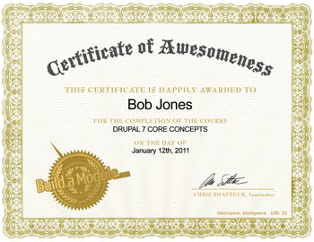
The New American Approach: Step 6: Construction Completion
Public Agency
Lease
Not-for-Profit Partner
Trustee
Private Property Management
Special Purpose Entity
Bond Underwriter
Developer
Architect
Development Team
Investors
General Contractor

Slide 40
The New American Approach: Step 7: Operations and Maintenance
Public Agency
Lease
Not-for-Profit Partner
Trustee
Private Property Management
Special Purpose Entity
Bond Underwriter
Developer
Architect
Development Team
Investors
General Contractor

Slide 41
The New American Approach: Step 7: Operations and Maintenance
Public Agency
Lease
Not-for-Profit Partner
Trustee
Special Purpose Entity
Bond Underwriter
Every 3-5 years
Investors
Private Property Management

Slide 42
The New American Approach: Lease Payments
Lease Payments
Public Agency
Lease
Not-for-Profit Partner
Trustee
Special Purpose Entity
Debt Service
Bond Underwriter
+
Operating Costs
+
Repair and Replacement Reserve
Investors
Private Property Management

Slide 43
The New American Approach: Unique Public Safeguards
Public Agency
Lease
Not-for-Profit Partner
Special Purpose Entity
Private Property Management

Slide 44
The New American Approach: Step 8: Transfer of Ownership
Public Agency
Lease
Not-for-Profit Partner
Trustee
Special Purpose Entity
Bond Underwriter
Paid in Full
Investors
Private Property Management

Slide 45
The New American Approach: Step 8: Transfer of Ownership
Public Agency
Ownership

Slide 46
When to use the American Approach
If the Public Agency views the activity as an essential governmental responsibility
If the protections from cost overruns and time delays are important
If lower operating costs are critical
If Specialized development skills are necessary
If long term property maintenance is a concern

Slide 47
63-20 Bonds
Revenue Ruling 63-20 allows a not-for-profit corporation to issue debt to finance a facility for tax exempt purposes, provided:
A local governmental entity endorses the financing
The facility will be occupied by a governmental or tax exempt entity
The facility reverts to the ownership of the endorsing local governmental entity at the retirement of the debt

Slide 48
Questions and Discussion

