Slide 1
S&P Global Ratings P3C Conference – Sustainable P3 Slides
Copyright © 2018 by S&P Global. All rights reserved.
26 February 2018

Slide 2
Ben Macdonald – about me
Director in the Infrastructure Practice at S&P Global Ratings
My team covers public private partnerships, projects and infrastructure companies.
Asset classes include power, renewables, tollways, light rail, airports – generally single asset projects.
I’m based in Denver (my team covers North America).
Previously I worked in the Structured Finance team in New York.
I had a previous career in software development
I have an MBA and hold a CFA designation, along with undergraduate degrees in electrical engineering, computer science and maths.

Slide 3
Categories of Ratings
Corporate
Entity that can change businesses over time, multiple issuances and assets
Debt issued by public entity
Often supported by taxing ability
Can be single asset, but may not be bankruptcy remote from the related government entity
Often used for DBT projects
Stand alone asset, with covenants limiting its purpose
Often for PPP and DBFOM projects
Public Finance
Project Finance

Slide 4
Project Finance Ratings
Generally for a single asset or small portfolio
Limitations on the ability to expand or change purpose.
Set up as independent entities (SPEs) that are arms length from corporate or private equity sponsors.
Project financing structure enables greater potential leverage than a corporate at the same rating level due to restrictions on purpose.
Rated on same scale as corporates, but we look through the debt term.
PPP (Public Private Partnerships) are usually structured and rated as a project financing
Example asset types:
Power
Gas Fired
Coal Fired
Renewables
Wind, Solar, Geothermal, Biomass
Transportation
Toll Roads, Bridges, Airports,
Light Rail
Social Infra.
Schools, Jails, Hospitals, Hotels, Stadiums
Industrial
Waste Processing,
LNG Plant,
Drillships,
Ethanol Plants

Slide 5
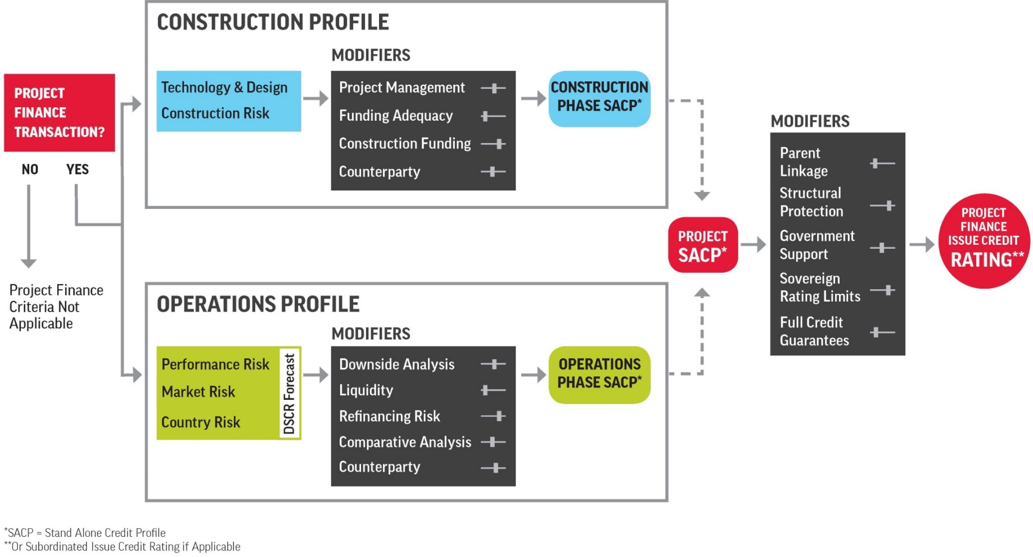
Project Finance Ratings Framework
8

Slide 6
Selected Rated Projects
Road/Bridge
LVR
Parking
Airport
Social/Real Estate
ABC Schools
Aspire Defence
Hospital Infra
Partners (NOH)
Plenary Health
Niagara
Availability
Central 70
Gordie Howe
East End Crossing
Goethals Bridge
Denver Great
Hall
Chicago Parking
Millenium Parking
Denver Conventn
Center Hotel
Yankees Stadium
Volume-Risk
I95 Express
407 East
407 International
ITR
Chicago Skyway
Purple Line
Grandlinq
Panama Airport

Slide 7
Key items in successful projects
Fair allocation of risk under the concession
Funding Sources
Political Acceptance
Experienced construction EPC contractors
Well defined need and scope
Bidding process decision based on multiple reasons, not just price.

Slide 8
Questions? Thank you
Ben Macdonald
Director
Global Infrastructure Ratings
T: 303 721 4723
C: 917 923 3780
ben.macdonald@spglobal.com

Slide 9
Copyright © 2018 by S&P Global Ratings. All rights reserved.
No content (including ratings, credit-related analyses and data, valuations, model, software or other application or output therefrom) or any part thereof (Content) may be modified, reverse engineered, reproduced or distributed in any form by any means, or stored in a database or retrieval system, without the prior written permission of S&P Global Rating or its affiliates (collectively, S&P). The Content shall not be used for any unlawful or unauthorized purposes. S&P and any third-party providers, as well as their directors, officers, shareholders, employees or agents (collectively S&P Parties) do not guarantee the accuracy, completeness, timeliness or availability of the Content. S&P Parties are not responsible for any errors or omissions (negligent or otherwise), regardless of the cause, for the results obtained from the use of the Content, or for the security or maintenance of any data input by the user. The Content is provided on an “as is” basis. S&P PARTIES DISCLAIM ANY AND ALL EXPRESS OR IMPLIED WARRANTIES, INCLUDING, BUT NOT LIMITED TO, ANY WARRANTIES OF MERCHANTABILITY OR FITNESS FOR A PARTICULAR PURPOSE OR USE, FREEDOM FROM BUGS, SOFTWARE ERRORS OR DEFECTS, THAT THE CONTENT’S FUNCTIONING WILL BE UNINTERRUPTED OR THAT THE CONTENT WILL OPERATE WITH ANY SOFTWARE OR HARDWARE CONFIGURATION. In no event shall S&P Parties be liable to any party for any direct, indirect, incidental, exemplary, compensatory, punitive, special or consequential damages, costs, expenses, legal fees, or losses (including, without limitation, lost income or lost profits and opportunity costs or losses caused by negligence) in connection with any use of the Content even if advised of the possibility of such damages.
Credit-related and other analyses, including ratings, and statements in the Content are statements of opinion as of the date they are expressed and not statements of fact. S&P’s opinions, analyses and rating acknowledgment decisions (described below) are not recommendations to purchase, hold, or sell any securities or to make any investment decisions, and do not address the suitability of any security. S&P assumes no obligation to update the Content following publication in any form or format. The Content should not be relied on and is not a substitute for the skill, judgment and experience of the user, its management, employees, advisors and/or clients when making investment and other business decisions. S&P does not act as a fiduciary or an investment advisor except where registered as such. While S&P has obtained information from sources it believes to be reliable, S&P does not perform an audit and undertakes no duty of due diligence or independent verification of any information it receives.
To the extent that regulatory authorities allow a rating agency to acknowledge in one jurisdiction a rating issued in another jurisdiction for certain regulatory purposes, S&P reserves the right to assign, withdraw or suspend such acknowledgement at any time and in its sole discretion. S&P Parties disclaim any duty whatsoever arising out of the assignment, withdrawal or suspension of an acknowledgment as well as any liability for any damage alleged to have been suffered on account thereof.
S&P keeps certain activities of its business units separate from each other in order to preserve the independence and objectivity of their respective activities. As a result, certain business units of S&P may have information that is not available to other S&P business units. S&P has established policies and procedures to maintain the confidentiality of certain non-public information received in connection with each analytical process.
S&P may receive compensation for its ratings and certain analyses, normally from issuers or underwriters of securities or from obligors. S&P reserves the right to disseminate its opinions and analyses. S&P's public ratings and analyses are made available on its Web sites, www.standardandpoors.com (free of charge), and www.ratingsdirect.com and www.globalcreditportal.com (subscription), and may be distributed through other means, including via S&P publications and third-party redistributors. Additional information about our ratings fees is available at www.standardandpoors.com/usratingsfees.

